Slide 1
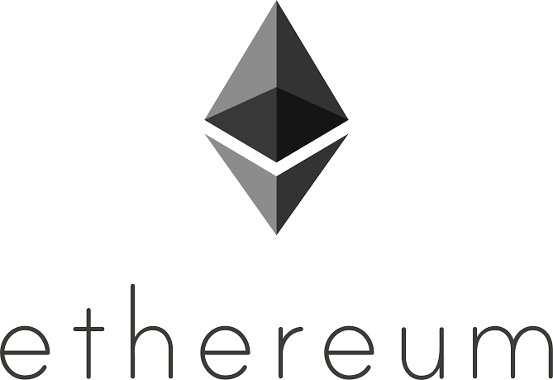

Slide 2
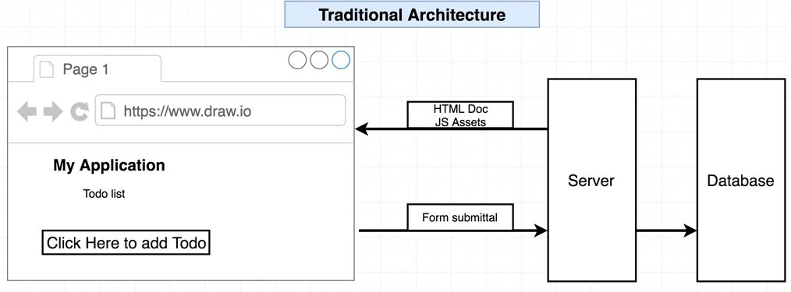
Working with front end..

Slide 3
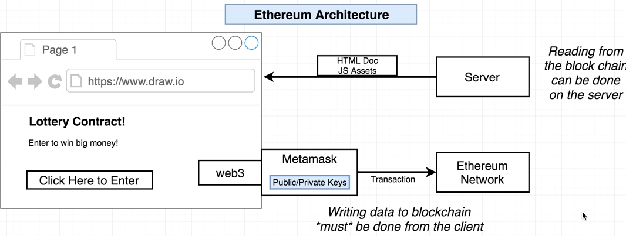
Ethereum architecture

Slide 4
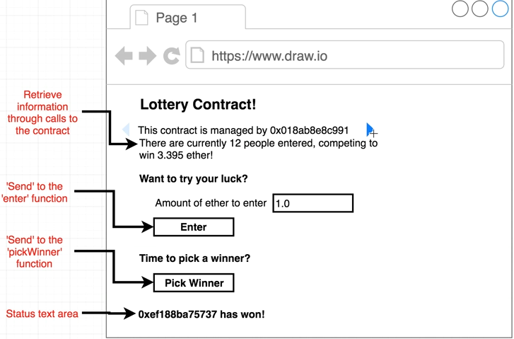
Lottery App
Npm install –g create-react-app
Create-react-app lottery-react

Slide 5
Default react page
The create-react-app command will create a dummy react project that we can build upon.
This will have index.html that will get rendered on the browser and will have app.js that is the main file we want to edit.
Then we run “npm run start” this will open the web browser with local host and will show the default screen.

Slide 6
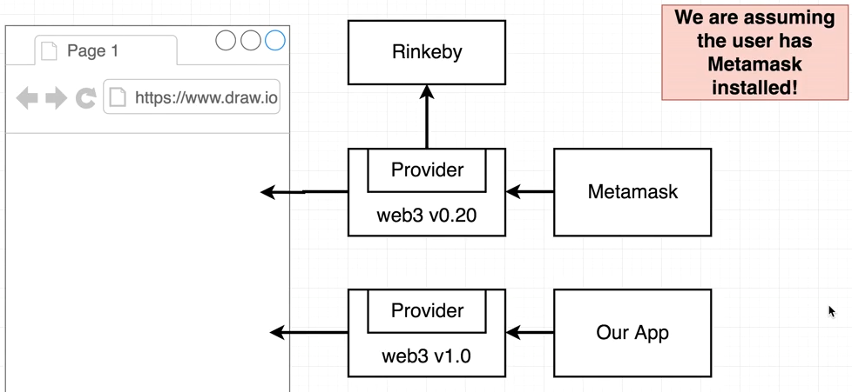
Npm install - -save web3@1.0.0-beta.26
We need to have our own version of web3 and need to use the provider given by metamask to link it to rinkeby network.

Slide 7
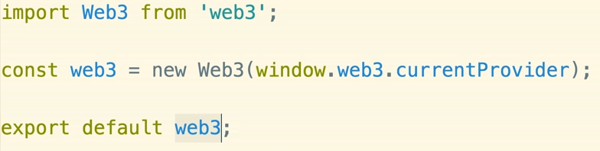
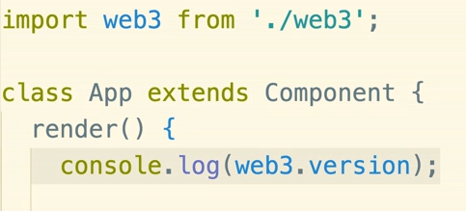
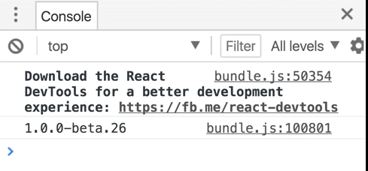
Web3.js for metamask provider
Create a new file in src named as web3.js
Import this file in app.js using

Slide 8
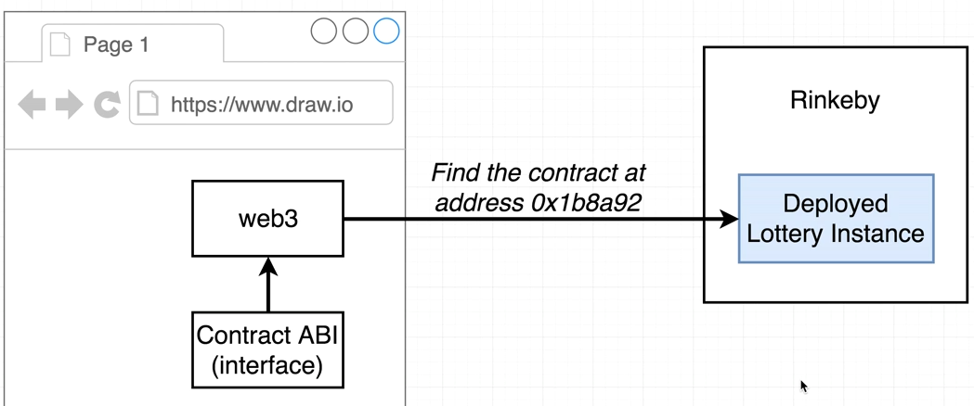
We need contract address and interface to connect it to web3.
We log these items on console from deploy.js file.

Slide 9
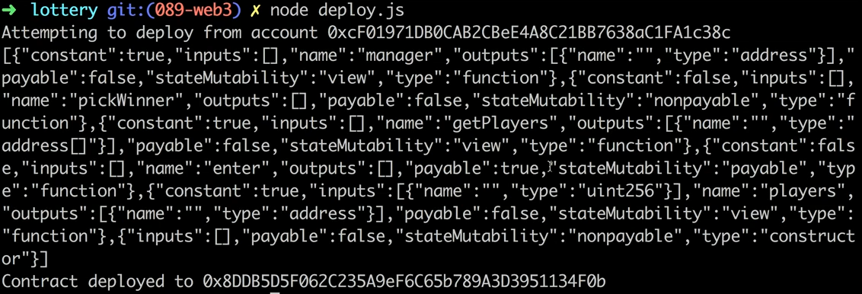
Address and interface on console

Slide 10
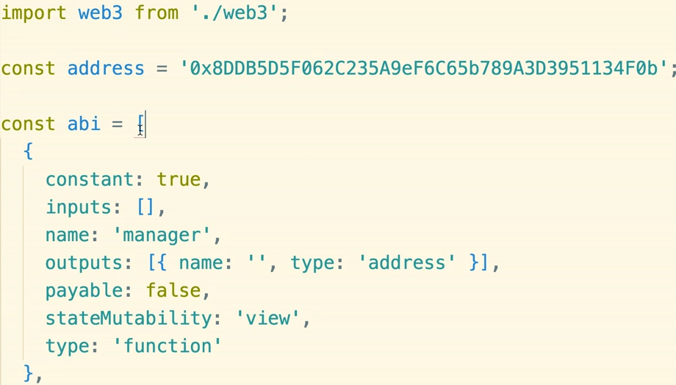
Use this information in react project
Create lottery.js in reach project. Add full interface

Slide 11
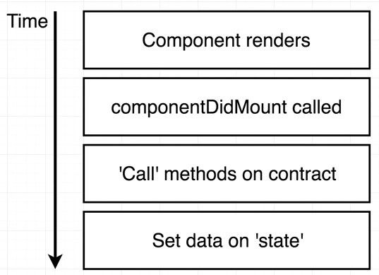
We will create a local copy of the contract using ABI and address on front end.
Now move to app.js in react project and import this lottery file.
componentDidMount is called
Only when the component is
Rendered on the screen.

Slide 12
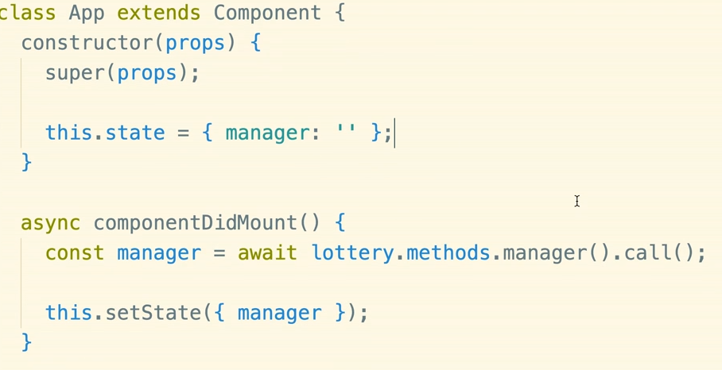
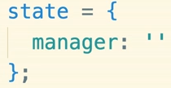
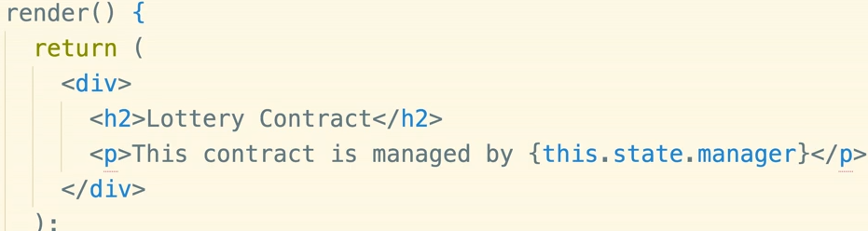
Set manager as state
In ES6 we can use the following syntax to create the state instead of constructor, props…

Slide 13
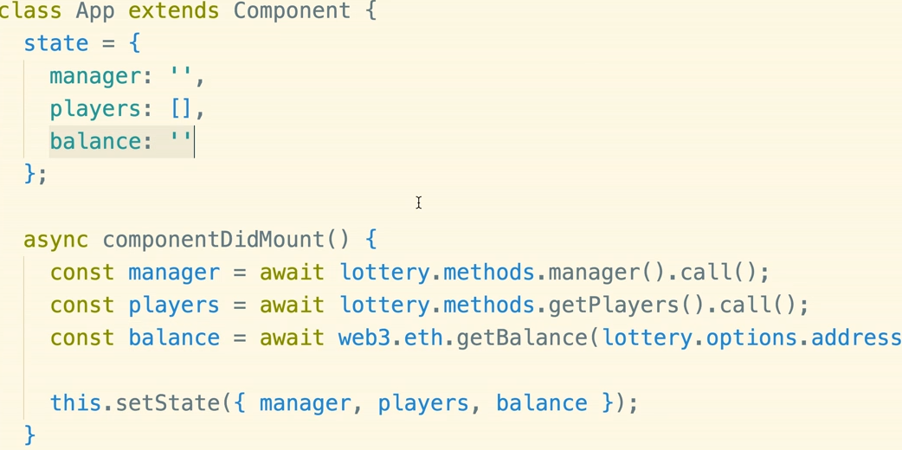
Getting more information

Slide 14
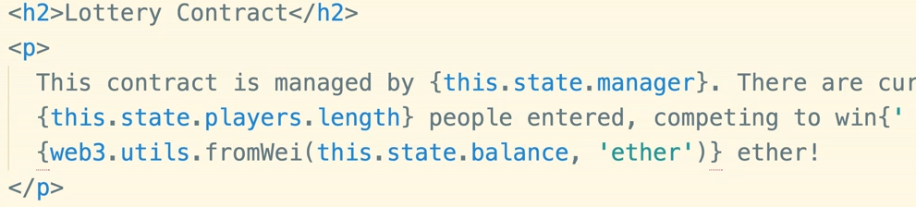
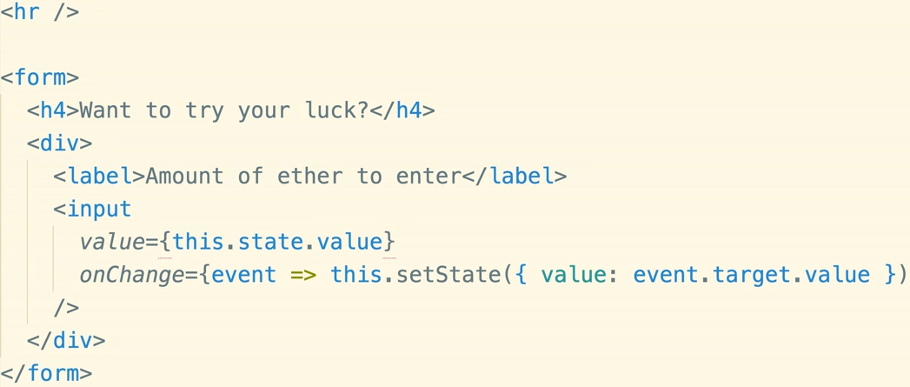
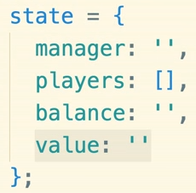
Render more on UI

Slide 15
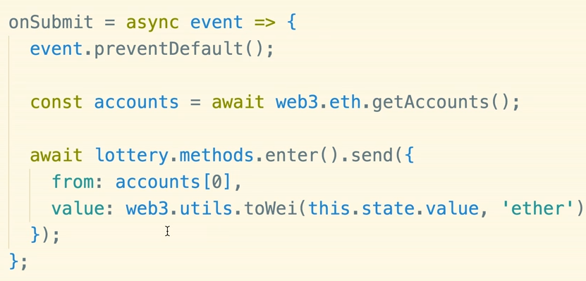
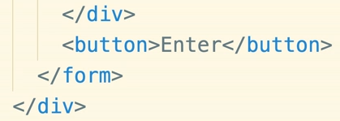
Enter button to enter lottery

Slide 16
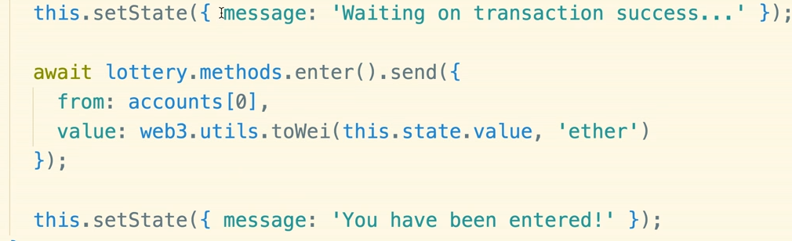
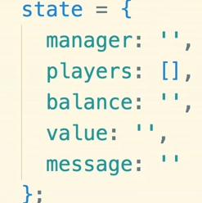
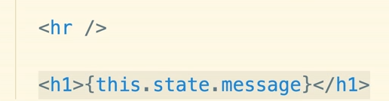
Showing transaction status to users

Slide 17
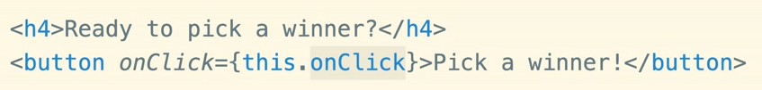
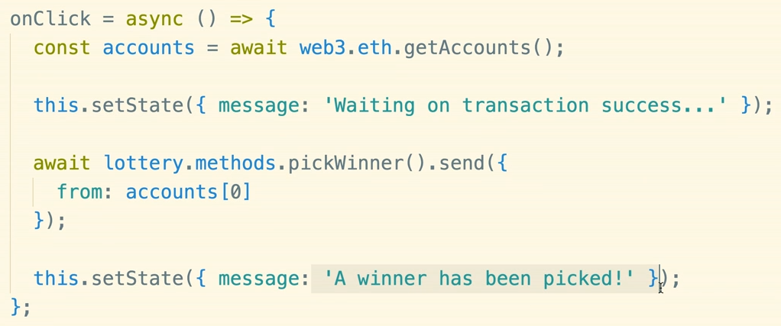
Pick a winner

